Slide 1
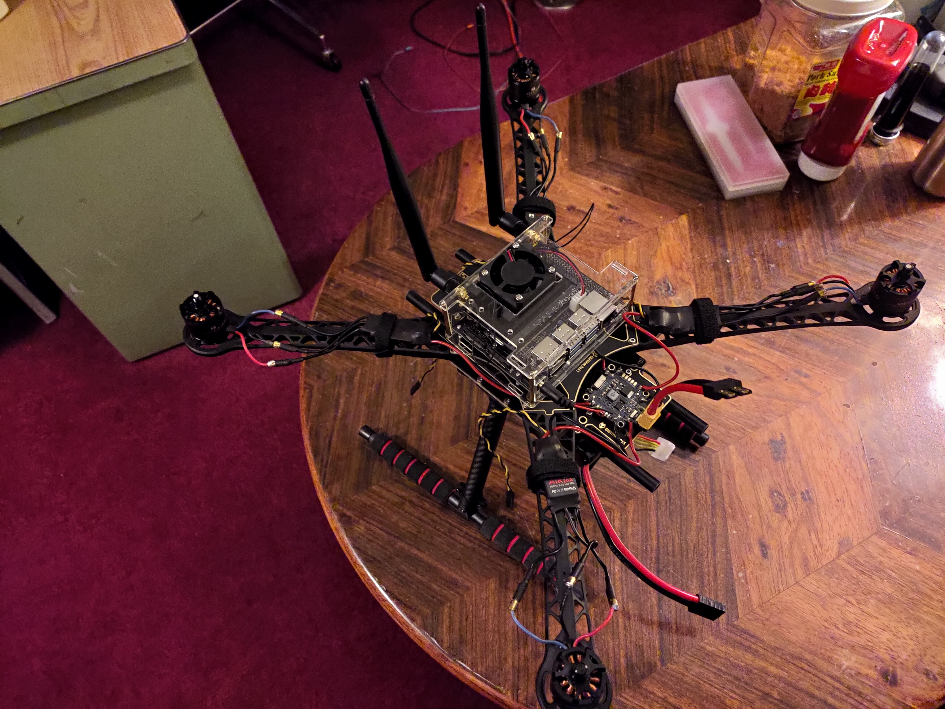
Full Custom Drone
By: Bruce Liu
Advisor: Ivo Georgiev

Slide 2
Process and Decisions (Overview)
Initial decisions
Interests
Design philosophy
Bill of materials
Motor consideration and requirements
Battery
Charger
Power distribution
Microprocessor
Wireless interface
Sensors
Current progress and plans

Slide 3
Initial Decisions
Bill of Materials
Waveshare AC8265 Wireless NIC Module for Jetson Nano $24.99
NVIDIA Jetson Nano Developer Kit $99.00
SMAKN DC 5V/4A 20W Switching Power Supply Adapter $9.99
Yahboom Acrylic Case for NVIDIA Jetson Nano $17.99
Readytosky S500 Quadcopter Frame $46.96
Tenergy TB6-B Balance Charger Discharger $64.99
Socokin 4S Lipo Battery 14.8V 6500mAh $95.39
Air Gear 450 motor, esc, propellor set $129.99
2PCS ShareGoo 12AWG Female XT60 wire $9.99
100PCS 2mm 3.5mm 4mm Female Male Gold Banana Bullet Connector $15.59
MCIGICM 10 Pair XT60H (XT60 Upgrade) Male Female Bullet Connectors Power Plugs $8.98
HiLetgo MPU9250/6500 9-Axis 9 DOF 16 Bit Gyroscope Acceleration Magnetic Sensor $8.99
KeeYees 3pcs BME280 Compatible with BMP280 Digital 5V Temperature Humidity Sensor Atmospheric Barometric Pressure $13.99
Velcro 3/8-inch Black Hook and Loop, 50-lb Tensile Strength, 25 Yards $12.72
HOBBYMATE XT60 PDB Power Distribution Board $9.90
Owned Materials
Screwdriver set
Soldering station
Soldering tips
Soldering tip cleaner
Rosin flux
Lab multimeter
Tin rosin core solder
Wire striper
Barrel jack connector
Desktop computer
Bread board
Jumper wires
Hole through PCB
Soldering Station with Six Flexible Arms
Multitool
tape
Extra Items
Camera
Thermal camera
Design Philosophy
buy vs make
incremental development
internal initial estimate
over spec in the case unknowns
targeted unknowns
test verification per step
auxiliary readiness
overhead for upgrades and future code
covid-19 considerations
Personal Interests satisfied by Drone project
scientific &/or engineering
advancement & research
sensors
control
power
computer hardware
electromagnetic spectrum
machine or deep learning

Slide 4
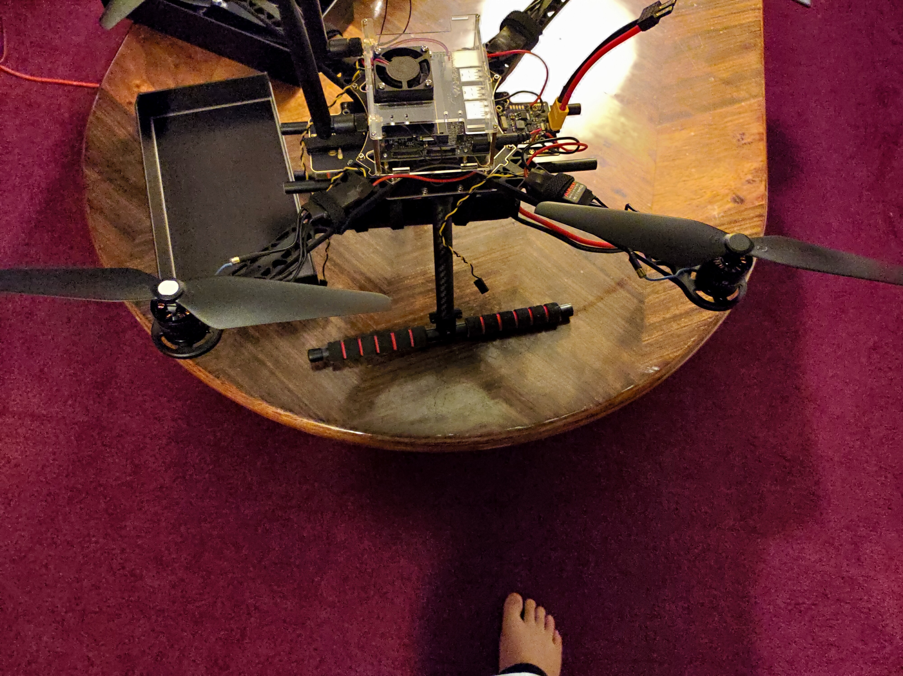
Motor Selection
Thrust
1.2Kg per motor
current mass 1lb
Power requirements
4S
1s = 3.7V
Quad motor interface
rotation CCW and CW
banana connection to esc
Power interface
ESC electronic speed controller
DC to 3 Phase AC

Slide 5
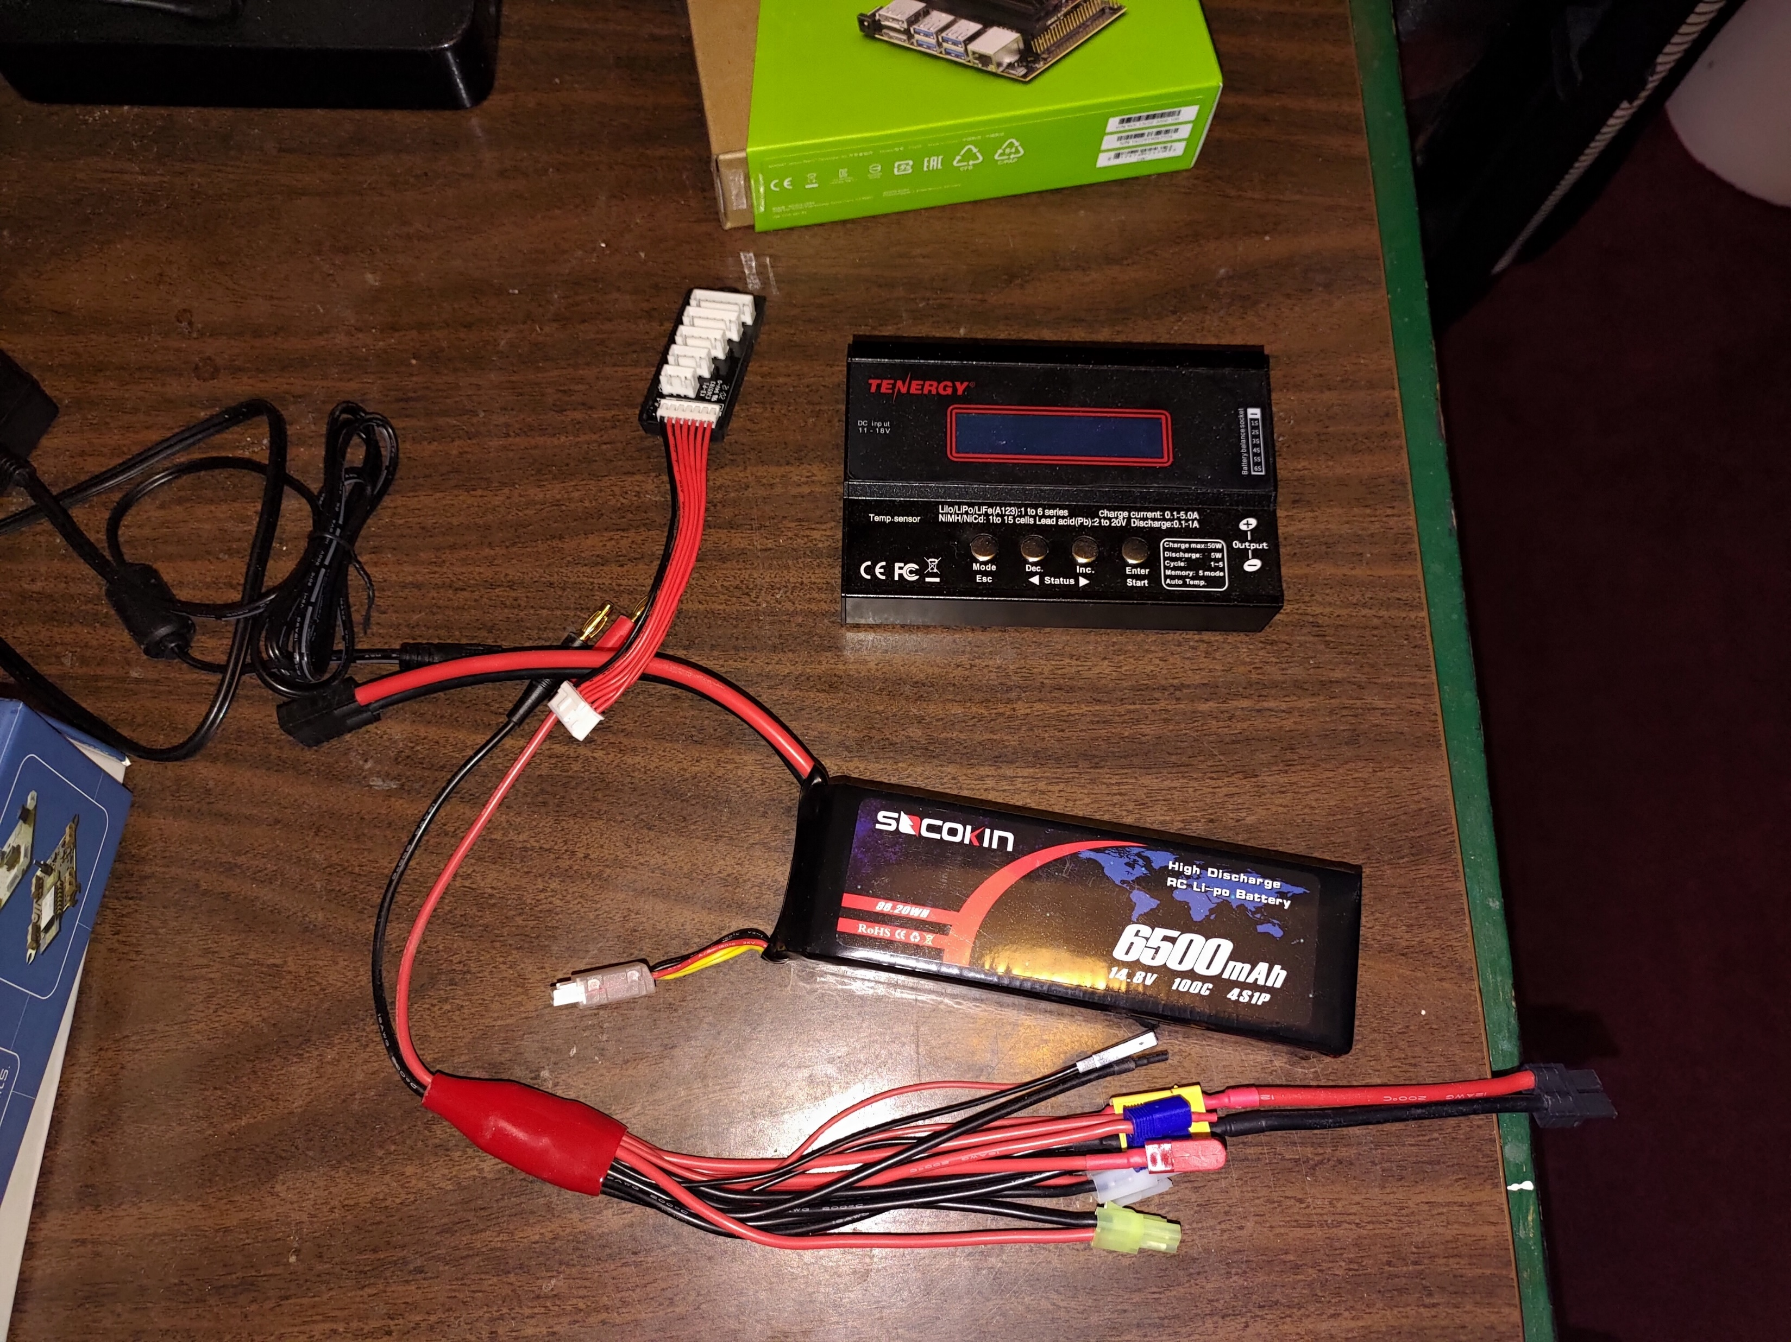
Battery
LIpo
Voltage matching for motor
Duration of flight
6500 milliAmp/H
Charger

Slide 6
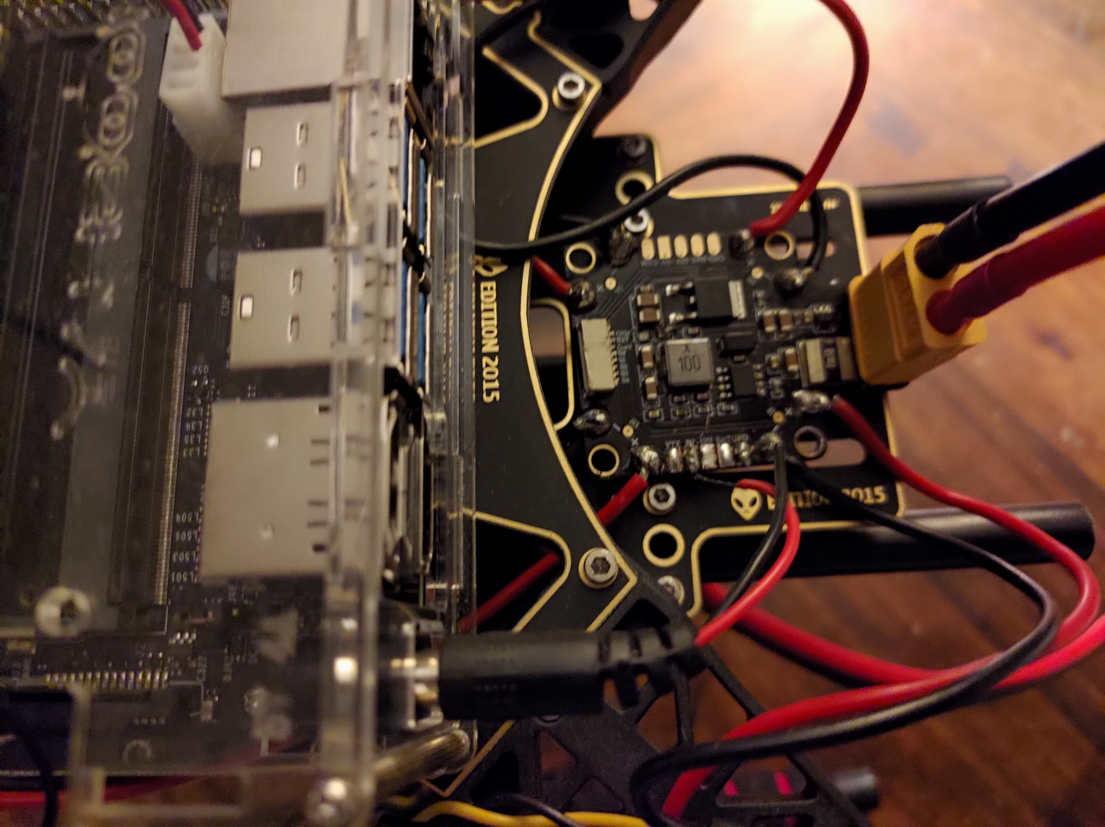
Power Distribution
HOBBYMATE XT60 PDB Power Distribution Board
Voltage range for battery and motors
Connection to battery
Traxxas RC to XT60
Power to four ESC to motors
Power via barrel jack to Microcontroller

Slide 7

Microprocessor or flight controller: Jensen nano
Can be replaced by peer’s flight controller.
CPU: 64-bit Quad-core ARM A57 @ 1.43GHz
GPU: 128-core NVIDIA Maxwell @ 921MHz
RAM: 4GB 64-bit LPDDR4 @ 1600MHz | 25.6 GB/s
Vin = 5V
Programing language : Python
GPIO library
servos library
image processing
machine learning
GPIO pins
sensor communication
Motor control via ESC
Case

Slide 8
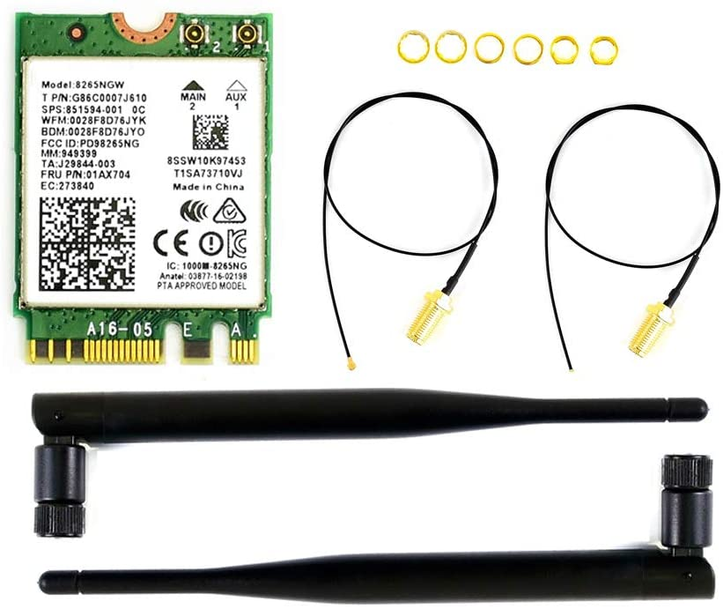
Wireless interface
Waveshare AC8265 Wireless NIC Module for Jetson Nano
2.4GHz / 5GHz Dual Band WiFi
Bluetooth 4.2
Peer controller or Phone app communication

Slide 9
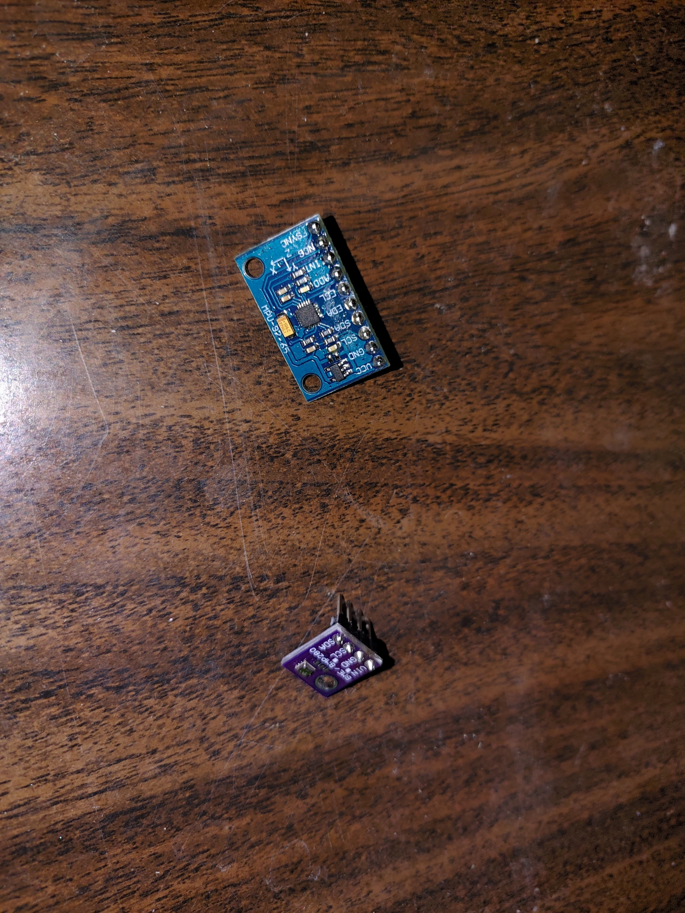
Sensors
I2C interface
IMU
Gyrometer
Accelerometer
Magnetometer
Barometer and temperature sensor
elevation
dew point
Sensor fusion

Slide 10
4700 Plans and Break
Increase mastery of python
Jenson nano software updates, and basic setup.
Hello world equivalent on Jensen nano.
Seek sensor library if they exist.
Sensor readout
Test values for sensors readout on breadboard.
Sensor fusion code and test.

Slide 11
4800 plans
Communication with phone controller apps
Phone controller readout.
Power and final wiring of sensor
Hole though PCB solder
Sensor velcroing
CC vs CCW wiring check.
Finalize wiring
Servo library and coding.
System control check.
Run Motor check.
Motor controller interface check.
Balance control check
Propeller installation
Power endurance test.
Outdoor testing

Slide 12
Extras
Camera interface
Machine learning obstacle avoidance
Thermal camera fever finding
Elevation data return and weather data computation.

Slide 13
Questions?

